Slide 1
ANP101: INTRODUCTORY ANIMAL PHYSIOLOGY (2 UNITS)
Course Outline
Characteristics of living things; Cellular basis of life: Cell organelles; Cell cycle, Cell division, Cell growth, Cell death.
Classification of Animal Kingdom, Grades of Organisation, A brief introduction of the various Animal Phyla: Protozoa, Coelenterata, Porifera, Platyhelminthes, Nematoda, Annelida, Mollusca, Arthropoda, Echinodermata, and Chordata.

Slide 2
Definition of Biology
Biology is the science that is focussed on the study of living things. The major branches of biology are:
  Anatomy, which deals with gross structure
  Physiology, which is the study of gross function or how the organism works
  Histology, the study of tissues
  Cell biology, the study of cells
  Microbiology, concerned with the study of fungi (mycology), bacteria (bacteriology) and viruses (virology)
  Biochemistry and Molecular Biology, study of living systems at the molecular level
  Genetics, study of inheritance
  Zoology, study of animals
  Botany, study of plants

Slide 3
Prokaryotes and Eukaryotes
2 general categories of cells:
  Prokaryotes – Organisms that lack a nuclear membrane, e.g. Bacteria
            Unicellular organisms, never differentiate into multi-cellular forms
            Lack cell organelles; plasma membrane performs most of the functions of cell organelles.
            Consist of 3 parts:
              Flagella and pili which are proteins attached to the cell surface
              Cell envelope consisting of a cell wall, a plasma membrane, and
              Cytoplasmic region containing the cell genome (DNA), ribosomes, etc.

Slide 4
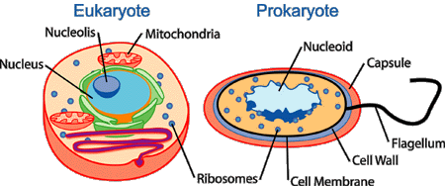

Slide 5
Prokaryotes and Eukaryotes, contd.
  Eukaryotes – Include fungi, animals, plants, and some unicellular organisms;
    about 10 x the size of prokaryotes and can be up to 1,000 x greater in volume
    Contain membrane-bound compartments in which specific metabolic activities take place
    Has a Nucleus – a membrane-bound compartment which contains the cell’s DNA
    Have other specialized structures called Organelles: Small structures within cells, performing dedicated functions.

Slide 6
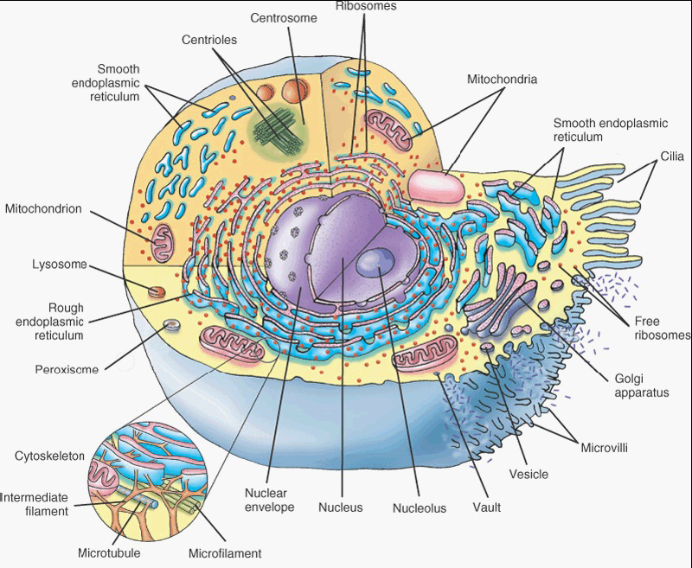
EXAMPLE OF A EUKARYOTIC CELL

Slide 7
The Plasma Membrane
Outer lining of the cell.
Separates and protects the cell from its surrounding environment
Made up of a double layer of lipid molecules and protein
Embedded proteins act as channels and pumps moving molecules in and out of the cell.
A form of plasma membrane found in prokaryotes is usually called the cell membrane.

Slide 8
The Cytoskeleton
Complex and dynamic cell component
Acts to organize and maintain the cell’s shape
Anchors organelles in place
Helps during endocytosis – the uptake of external materials by a cell
Moves parts of the cell in processes of growth and motility
A great number of proteins are associated with the cytoskeleton, controlling a cell’s structure by directing, bundling and aligning filaments.

Slide 9
The Cytoplasm
Internal, fluid-filled space of the cell
Also called The Cytosol
In eukaryotes all cell organelles reside in the cytosol
It is also home to the cytoskeleton
Contains dissolved nutrients
Helps to break down waste products
Moves materials around the cell through a process known as cytoplasmic streaming
Contains many salts and is an excellent conductor of electricity.

Slide 10
The Nucleus
Most conspicuous organelle found in eukaryotic cell
Contains the cell’s chromosomes
Place where almost all DNA replication and RNA synthesis occurs
Spheroid in shape and separated from the cytosol by the nuclear membrane
Nuclear membrane isolates and protects a cell’s DNA from molecules that could accidentally damage its structure or interfere with its processes.
DNA is transcribed, forming Messenger RNA (mRNA)
mRNA is transported to the cytosol where it is translated into a specific protein molecule
In prokaryotes, DNA processing takes place in the cytoplasm.

Slide 11
The Ribosome
Found in both prokaryotes and eukaryotes
Composed of large complex molecules, including RNAs and Proteins
Responsible for processing genetic instructions carried by a mRNA
Process of converting the genetic code carried by a mRNA into the correct sequence of amino acids that make up a protein is called Translation
There are usually large numbers of ribosomes in a cell as protein synthesis is extremely important for proper functioning of cells
Ribosomes float freely in the cytosol but are sometimes bound to the endoplasmic reticulum
Ribosomes comprise of one large and one small subunit, each having a different function during protein synthesis

Slide 12
Mitochondria
Self-replicating organelles found in cytoplasm of all eukaryotic cells
Occur in various numbers, shapes and sizes
They contain their own genome separate and distinct from the nuclear genome of a cell
Have 2 functionally distinct membrane systems separated by a space:
  Outer membrane which surrounds the whole organelle, and
  Inner membrane which form folds called Cristae
    Number and shape of cristae in mitochondria vary with tissue and organism in which they are found

Slide 13
Glycolysis
Play critical role in generating energy in eukaryotic cell; process involves complex pathways
Glycolysis (1st pathway) requires no oxygen and is referred to as anaerobic metabolism
  Occurs in the cytoplasm, outside the mitochondria
  Glucose is broken down into pyruvate; each reaction produces some hydrogen ions which are then used to make ATP
  4 molecules of ATP are made from one molecule of glucose in glycolysis
  In prokaryotes, glycolysis is the only pathway used for converting energy

Slide 14
Kreb’s cycle or Citric acid cycle
Kreb’s cycle or Citric acid cycle:
  Occurs inside the mitochondria
  Capable of generating enough ATP to run all the cell functions
  Cycle begins with glucose molecule which is stripped of some of its hydrogen atoms to form two molecules of pyruvic acid
  Next, pyruvic acid is altered by removal of a carbon and 2 oxygen atoms which form CO₂
  When the CO2 is removed, energy is given off and a molecule of NAD+ is converted into the higher energy form, NADH.
  Another molecule, coenzyme A, then attaches to the remaining acetyl unit to form acetyl CoA
  Acetyl CoA joins a 4-carbon molecule (oxaloacetate) to form citric acid, a 6-carbon molecule

Slide 15
Kreb’s cycle or Citric acid cycle, contd.
  Citric acid is broken down and modified in a step-wise fashion, a process leading to the release of hydrogen ions and carbon molecules
  The carbon molecules are used to make more carbon dioxide
  The hydrogen ions are picked up by NAD and FAD (flavin-adenine dinucleotide)
  Eventually oxalate is again produced and the process starts again.
  Kreb’s cycle is capable of generating between 24 and 28 ATP molecules from one glucose molecule converted to pyruvate.

Slide 16
Chloroplasts and Mitochondria
Chloroplasts are similar to mitochondria but are found only in plants
Both are surrounded by a double membrane with an inter-membrane space
Both have their own DNA
Both are involved in energy metabolism
Both have reticulations or foldings filling their inner space
Chloroplasts convert light energy from the sun into ATP through photosynthesis

Slide 17
Endoplasmic reticulum and
Golgi apparatus
Endoplasmic reticulum (ER) – the transport network for molecules targeted for certain modifications and specific destinations within the cytoplasm
Two forms: Rough ER and Smooth ER.
Rough ER – has ribosomes adhering to its outer surface
Smooth ER – has no adhering ribosomes
Translation of the mRNA for proteins that will either stay in the ER or exported occurs at the ribosomes attached to the RER.
The SER serves as the recipient for proteins synthesized in the RER.
Proteins for export are passed to the Golgi body for further processing, packaging and transport to other cellular locations.

Slide 18
Lysosomes and Peroxisomes
Both organelles are spherical, bound by a single membrane and rich in digestive enzymes.
Lysosomes contain >36 enzymes for degrading proteins, nucleic acids and polysaccharides. These enzymes are most active at low pH, reducing the risk of autolysis.
This shows the importance of compartmentalization in eukaryotic cells.
Peroxisomes often resemble a lysosome, but:
  Peroxisomes are self-replicating while lysosomes are formed in the Golgi complex
  Peroxisomes also have membrane proteins which are critical for various functions, such as importing proteins into their interiors and to proliferate and segregate into daughter cells.

Slide 19
What Is pH?
The term pH derives from a combination of "p" for the word power and "H" for the symbol of the element hydrogen. pH is the negative log of the activity of hydrogen ions and represents the "activity" of hydrogen ions in a solution at a given temperature. The term activity is used because pH reflects the amount of available hydrogen ions, not the concentration of hydrogen ions. The pH scale for aqueous solutions ranges from 0 to 14 pH units, with pH 7 being neutral. A pH of less than 7 means that the solution is acidic, whereas a pH of more than 7 means that the solution is basic.

Slide 20
Lysosomes and Peroxisomes, contd.
Functions of lysosome:
  Digests foreign bacteria that invade a cell
  Helps to recycle receptor proteins and other membrane components
  Degrades worn out organelles such as mitochondria
  Can help repair damage to the plasma membrane by serving as a membrane patch, sealing the wound.

Slide 21
Lysosomes and Peroxisomes, contd.
Functions of peroxisome:
  Rids the body of toxic substances such as hydrogen peroxide or other metabolites
  Contain enzymes concerned with oxygen utilization
  Present in high numbers in the liver where toxic byproducts are known to accumulate
  All enzymes found in a peroxisome are imported from the cytosol
  Each enzyme transferred to a peroxisome has a special sequence at one end of the protein, called peroxisomal targeting signal (PTS)
  PTS allows the protein to be taken into that organelle, where they rid the cell of toxic substances.

Slide 22
THE CELL CYCLE
Cell cycle: Sequence of events which occurs between one cell division and the next.
        It has 3 stages:
    1) Interphase
      period of synthesis and growth
      Cell produces many materials required for its own growth and for carrying out all its functions
      DNA replication occurs during this stage
    2) Mitosis
      Process by which the cell nucleus divides to produce 2 daughter nuclei containing identical sets of chromosomes to the parent cell
    3) Cell division
      Process of division of the cytoplasm into 2 daughter cells

Slide 23
PROPHASE
MITOSIS
METAPHASE
ANAPHASE
G1 + S + G2 = CELLULAR SYNTHESIS
TELOPHASE
G₂
CELL DIVISION
S
M
INTERPHASE
G₁
THE CELL CYCLE CHART

Slide 24
Key to the Cell Cycle chart
Phase | Events within cell
G₁ | Intensive cellular synthesis, including cell organelles. Cell metabolic rate high. Cell growth occurs. Substances produced to inhibit or stimulate onset of next phase as appropriate.
S | DNA replication occurs. Protein molecules called histones are synthesized and cover each DNA strand. Each chromosome becomes two chromatids. At this stage the cell is 4n (4 copies of each DNA molecule, 2 in each homologous chromosome).
G₂ | Intensive cellular synthesis. Mitochondria and chloroplasts divide. Energy stores increase. Mitotic spindle begins to form.
M | Nuclear division occurs in 4 phases.
C | Equal distribution of organelles and cytoplasm into each daughter cell.

Slide 25
MITOSIS
Interphase
  Varies in duration depending on the function of the cell
  DNA of each chromosome replicates just before nuclear division
  Each chromosome now exists as a pair of chromatids joined together by a centromere
  The cell is 4n at this stage (4 copies of each DNA molecule, 2 in each chromosome of a homologous pair
  During this phase chromosome material is in the form of very loosely coiled threads called chromatin
  Centrioles have replicated.
Prophase
  This is usually the longest phase of division
  Chromosomes shorten and thicken by coiling and tighter packaging of their components
  In animal cells the centrioles move to opposite poles of the cell
  Short microtubules called asters may be seen radiating from the centrioles
  The nucleoli disappear as their DNA passes to certain chromosomes.
  The nuclear envelope breaks up into small vesicles which disperse.
  A spindle is formed.

Slide 26
Mitosis contd.
Metaphase
  Chromosomes line up around the equator of the spindle
  They are attached by their centromeres to the spindle fibres which are microtubules
Anaphase
  Very rapid stage
  Centromeres split in 2
  Spindle fibres pull the daughter centromeres to opposite poles
  Separated chromatids are pulled along behind the centromeres
Telophase
  Chromatids reach the poles of the cell
  They uncoil and lengthen to form chromatin again, losing visibility
  Spindle fibres disintegrate
  Centrioles replicate
  A nuclear envelope reforms around the chromosomes at each pole
  Nucleoli reappear

Slide 27
Mitosis contd.
Cytokinesis
  Cytokinesis is the division of the cytoplasm
  Normally follows telophase and leads into the G1 phase of interphase
  In preparation for cell division, cell organelles become evenly distributed towards the 2 poles of the telophase cell along with the chromosomes
  In animal cells the cell surface membrane starts to invaginate towards the region previously occupied by the spindle equator
  Microtubules probably draw in the cell surface membrane to form a furrow around the outer surface of the cell
  Cell surface membranes in the furrow eventually join up to completely separate the 2 cells.
Significance of mitosis
  Genetic stability
  Growth
  Cell replacement
  Regeneration
  Asexual reproduction

Slide 28
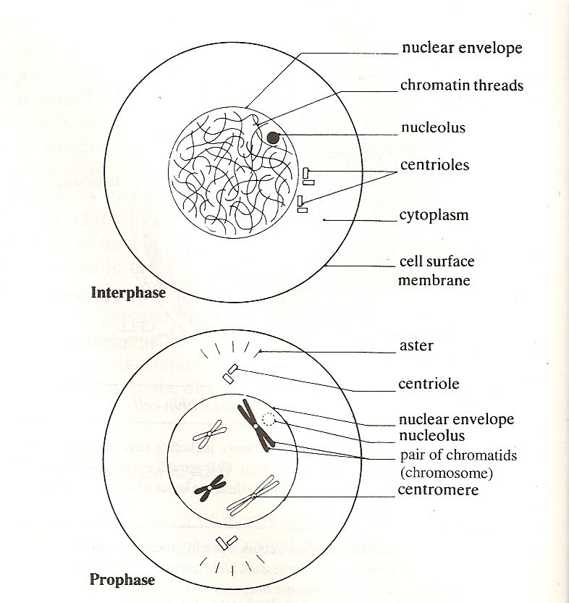

Slide 29
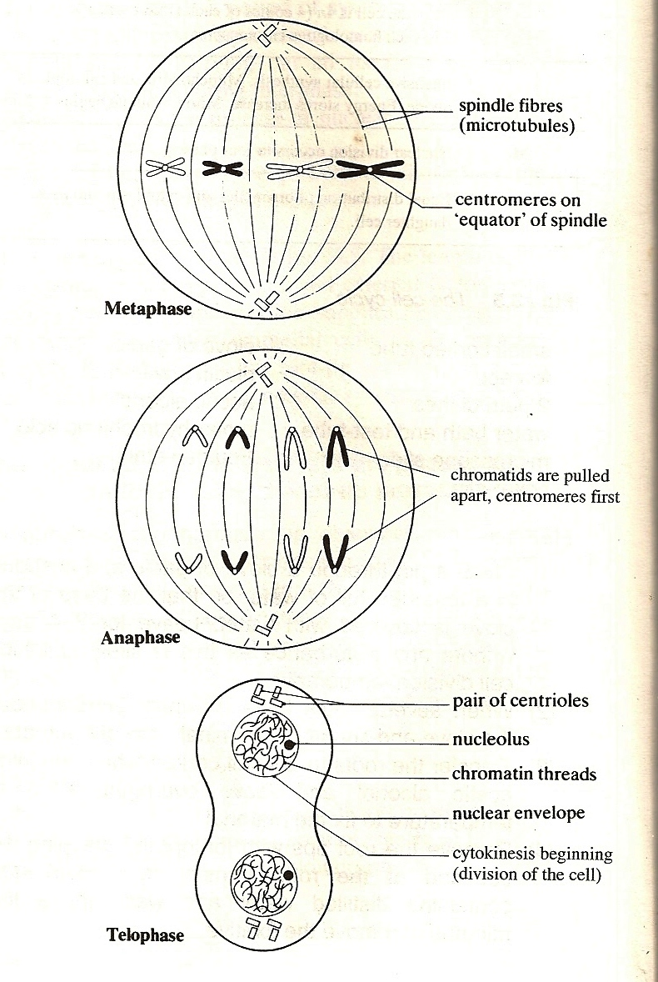

Slide 30
MEIOSIS
Form of nuclear division in which the chromosome number is halved from the diploid number (2n) to the haploid number (n)
Like mitosis, it involves DNA replication during interphase in the parent cell
This is followed by 2 cycles of nuclear divisions and cell divisions known as meiosis I (the 1st meiotic division) and meiosis II (the 2nd meiotic division)
Thus a single diploid cell gives rise to 4 haploid cells
Meiosis occurs during the formation of sperm and eggs in animals.

Slide 31
Meiosis I
Prophase I
  Chromosomes shorten and become visible
  Homologous chromosomes pair up in a process called synapsis
    Each pair is called a bivalent
    One of the pair comes from the male parent and one from the female parent
  The homologous chromosomes appear to repel each other and partially separate
    Each chromosome is now seen to be composed of 2 chromatids
    The 2 chromosomes are seen to be joined at several points along their length, called chiasmata
    Each chiasma is the site of an exchange between chromatids
    Genes from one chromosome (e.g. paternal) may swap with genes from the other (maternal) leading to new gene combinations in the resulting chromatids: This is called crossing over.

Slide 32
Meiosis I, contd.
Metaphase I
  The bivalents become arranged around the equator of the spindle, attached by their centromeres
Anaphase I
  Spindle fibres pull homologous chromosomes, centromeres first, towards opposite poles of the spindle
  Chromosomes are separated into 2 haploid sets, one at each end of the spindle

Slide 33
Meiosis I, contd.
Telophase I
  Arrival of homologous chromosomes at opposite poles marks the end of meiosis I
  Halving of chromosome number has occurred but the chromosomes are still composed of 2 chromatids
  Spindle fibres usually disappear
  The chromatids uncoil and a nuclear envelope re-forms at each pole and the nucleus enters interphase
  Cleavage occurs as in mitosis
Interphase II
  Present only in animal cells
  Varies in duration
  No further DNA replication occurs.

Slide 34
Meiosis II
Meiosis II is similar to mitosis
Prophase II
  Stage is absent if interphase II is absent
  Nucleoli and nuclear envelope disperse
  Chromatids shorten and thicken
  Centrioles move to opposite poles of the cells
  At the end of the phase spindle fibres appear, arranged at right angles to the spindle of meiosis I
Metaphase II
  Chromosomes line up separately around the equator of the spindle
Anaphase II
  Centromeres divide
  Spindle fibres pull the chromatids to opposite poles, centromeres first

Slide 35
Meiosis II, contd.
Telophase II
  4 haploid daughter cells are formed
  Chromosomes uncoil, lengthen and become indistinct
  Spindle fibres disappear
  Centrioles replicate
  Nuclear envelopes re-form around each nucleus
  Each nucleus now contains haploid number of chromosomes
  Cleavage formation results in production of 4 daughter cells.

Slide 36
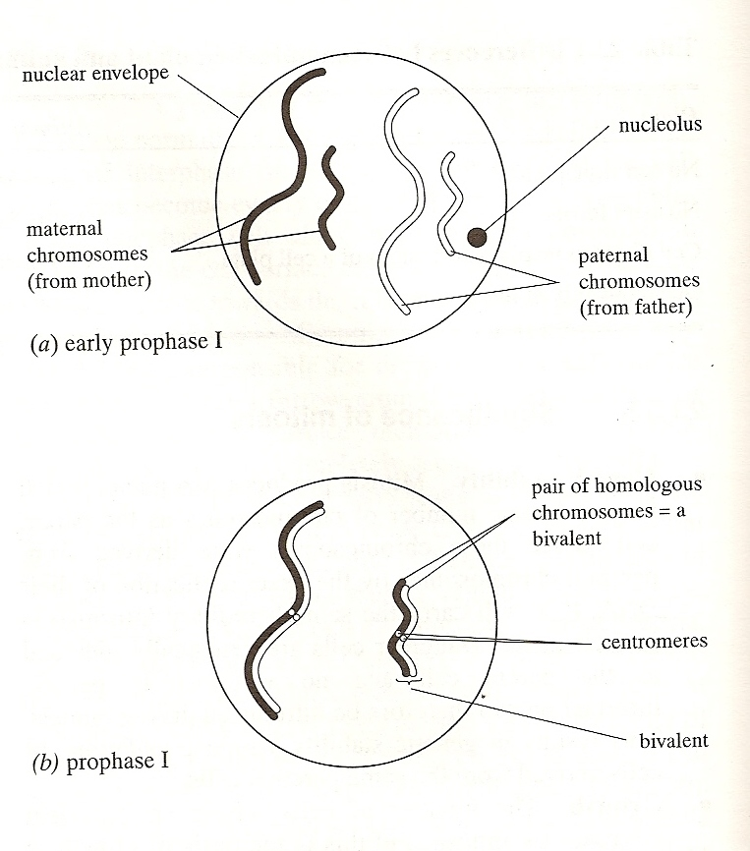

Slide 37
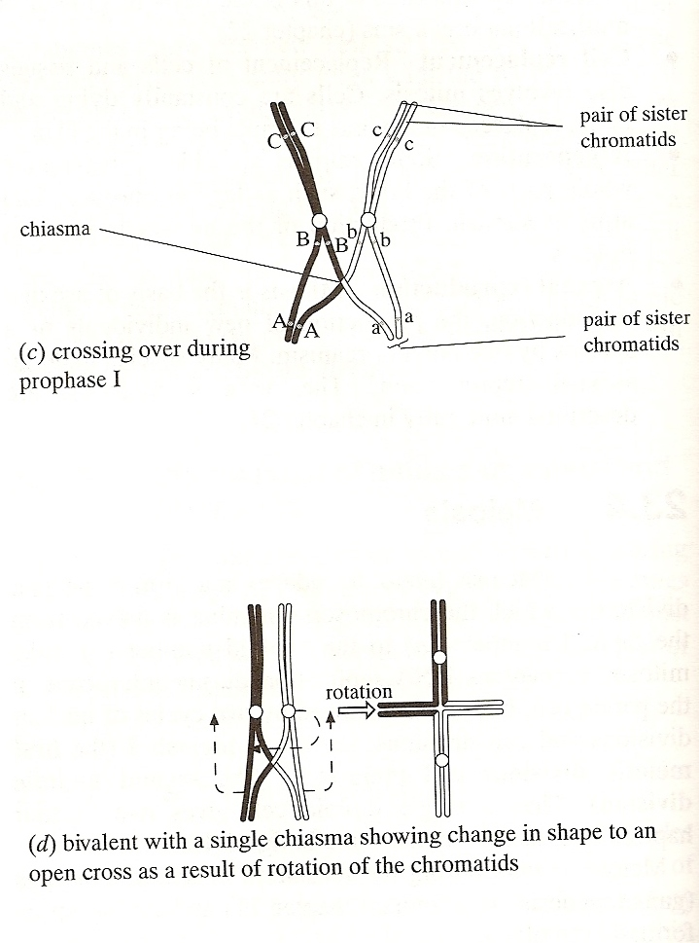

Slide 38
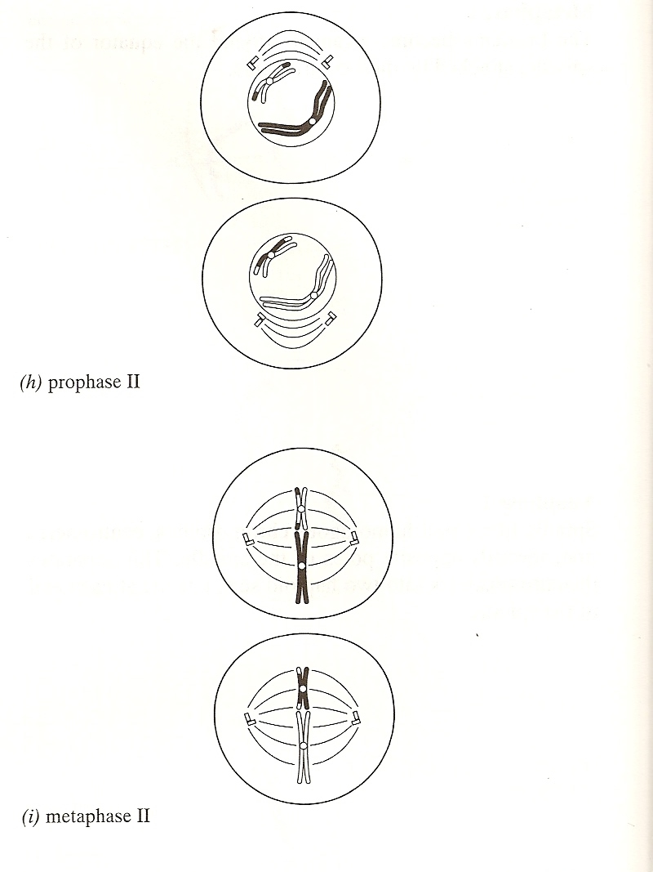

Slide 39
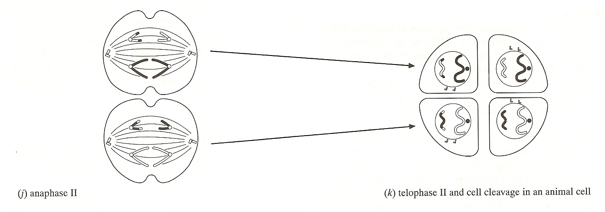

Slide 40
CELL ADAPTATION, CELL INJURY and CELL DEATH
I. DEFINITIONS AND TERMINOLOGY
1) Homeostasis
Homeostasis is the maintenance of constant internal environment. Ability to maintain a steady state within a constantly changing environment is essential for the survival of living system.
Cells are able to maintain normal structure and function (e.g. ion balance, pH, energy metabolism) in response to normal physiologic demands.

Slide 41
CELL ADAPTATION, CELL INJURY and CELL DEATH contd…
2) Cellular Adaptation
As cells encounter stresses, either excessive physiologic demand or some pathologic stimuli, they may make functional or structural adaptations to maintain viability / homeostasis.
Cells may respond to these stimuli by either increasing or decreasing their content of specific organelles.
Adaptive processes: atrophy, hypertrophy, hyperplasia and metaplasia are forms of adaptation.

Slide 42
CELL ADAPTATION, CELL INJURY and CELL DEATH, contd.
3) Cell Injury
If the limits of adaptive response are exceeded, or in certain instances when adaptation is not possible, a sequence of events called cell injury occurs.
a) Reversible Cell Injury
removal of stress will result in complete structural and functional integrity to be restored.

Slide 43
CELL ADAPTATION, CELL INJURY and CELL DEATH, contd.
b) Irreversible Cell Injury / Cell Death
if stimulus persists (or severe enough from the start) the cell will suffer irreversible cell injury and death.
cell death is one of the most crucial events in pathology and can affect any type of cell.
two principle morphologic patterns that are indicative of cell death:
Necrosis: type of cell death characterized by severe membrane injury and enzymatic degradation; always a pathologic process.
Apoptosis: regulated form of cell death; can be physiologic or pathologic process.

